Slide 1
Guide to Install Add-in file ‘StockTaking55.xlam’ in Excel

Slide 2
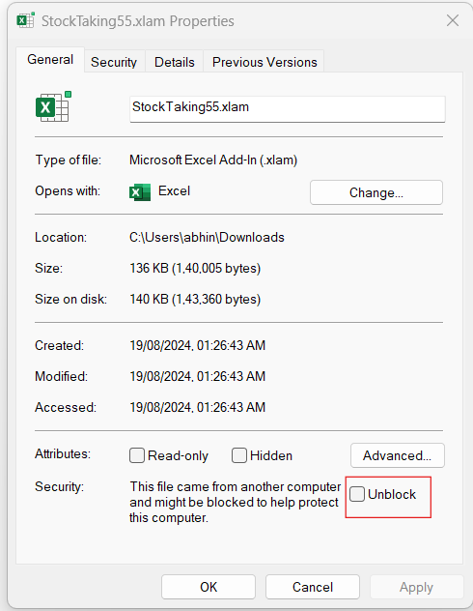
Once ‘StockTaking55.xlam’ file downloaded in your local drive, Right click on the file and click on properties and tick on Unblock box to Unblock the file.
Do not try to open ‘StockTaking55.xlam’ file by double clicking. It won’t install like that way.

Slide 3
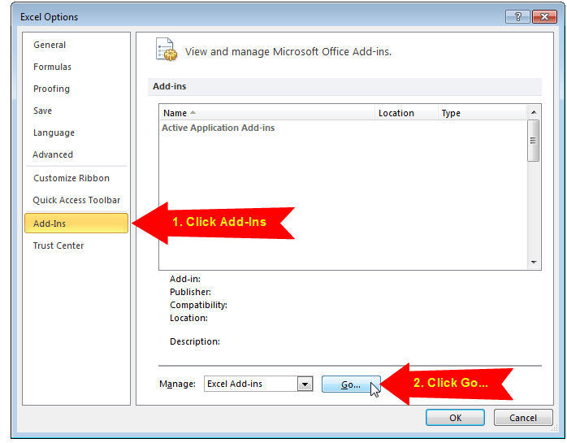
In Excel go to menu File > Options
Click the “Add-Ins” option on the left-side menu, and then click the “Go…” button. – You may have to wait a few seconds for the window to appear.

Slide 4
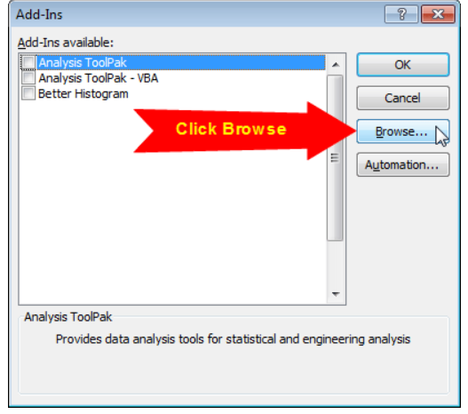
Click the “Browse…” button on the Add-Ins Menu.

Slide 5
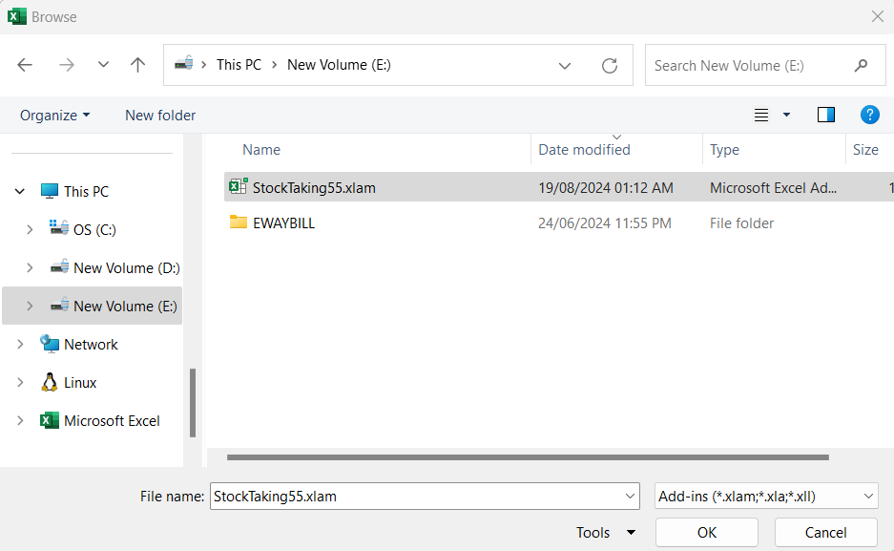
Locate the add-in file StockTaking55.xlam where you have saved the file, and click OK.
The Add-in will appear in the list and enabled, click OK.

Slide 6
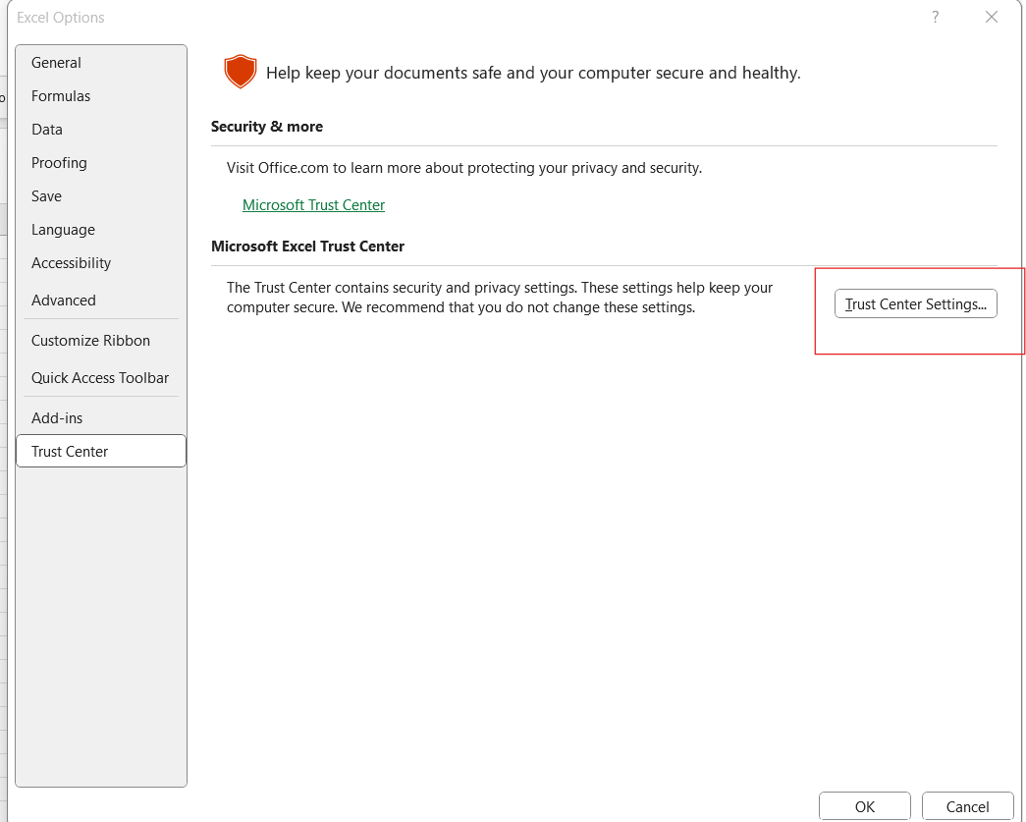
Again Open the Excel Options menu File > Options > Trust Center > Trust Center Settings.. > Ok

Slide 7
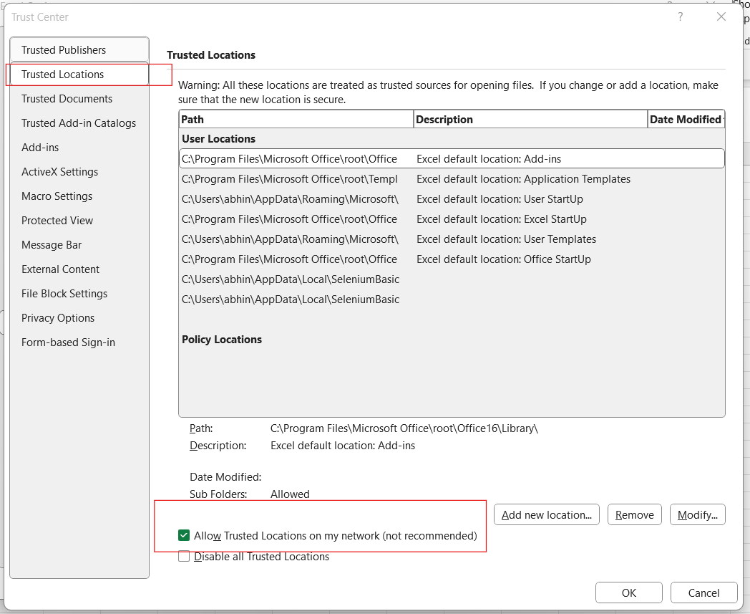
Click on Trusted Locations > Tick on Allow Trusted Locations on my network

Slide 8
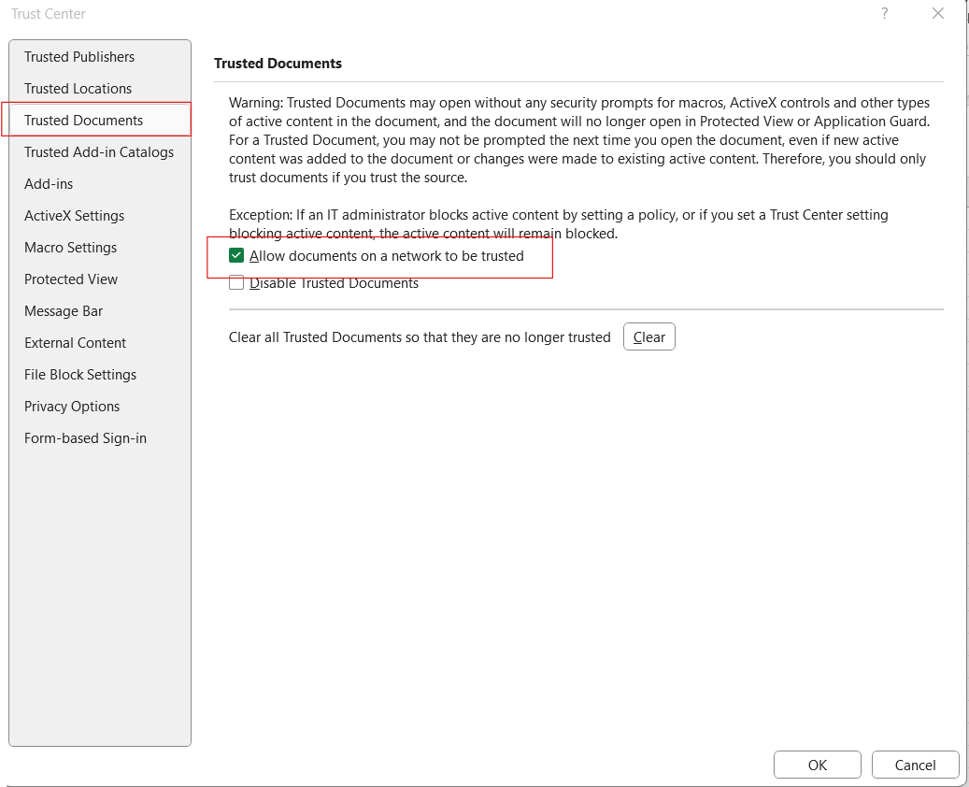
Click on Trusted Documents > Tick on Allow documents on a network to be trusted

Slide 9
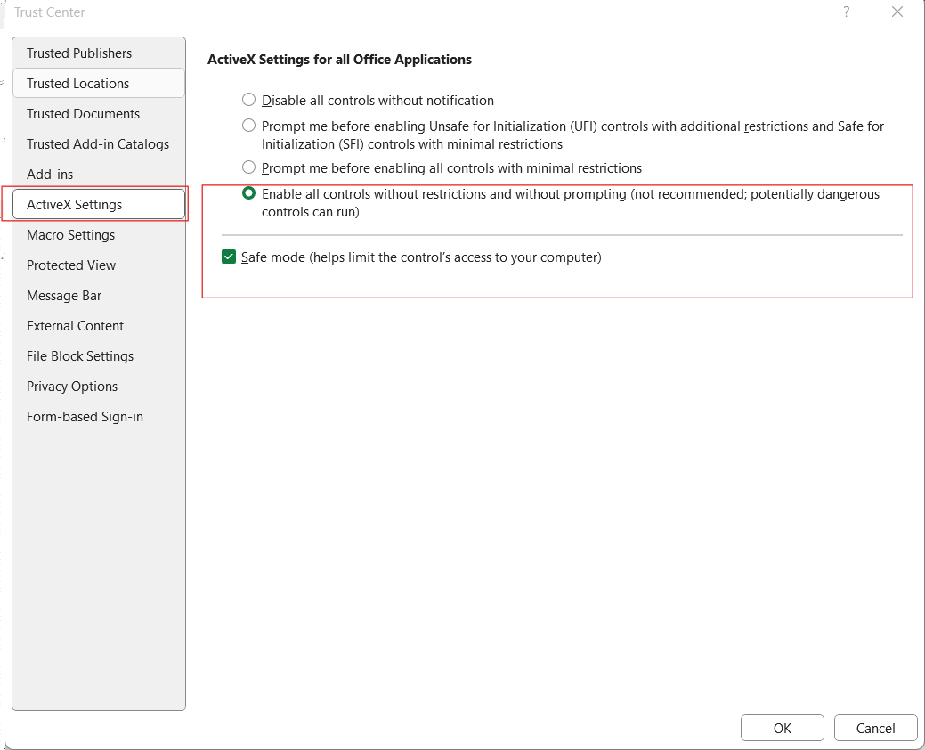
Click on ActiveX Settings > Select Only ‘Enable all controls without restrictions’ > Tick on Safe mode

Slide 10
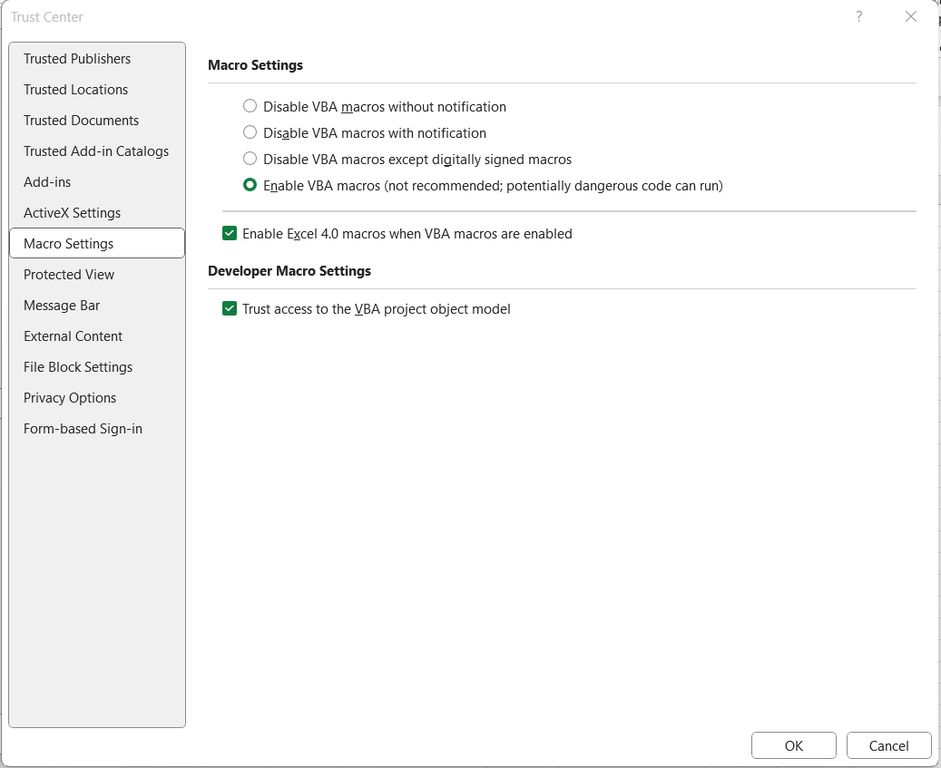
Click on Macro Settings > Select Only ‘Enable VBA macros’ > Tick on Trust access to the VBA project

Slide 11
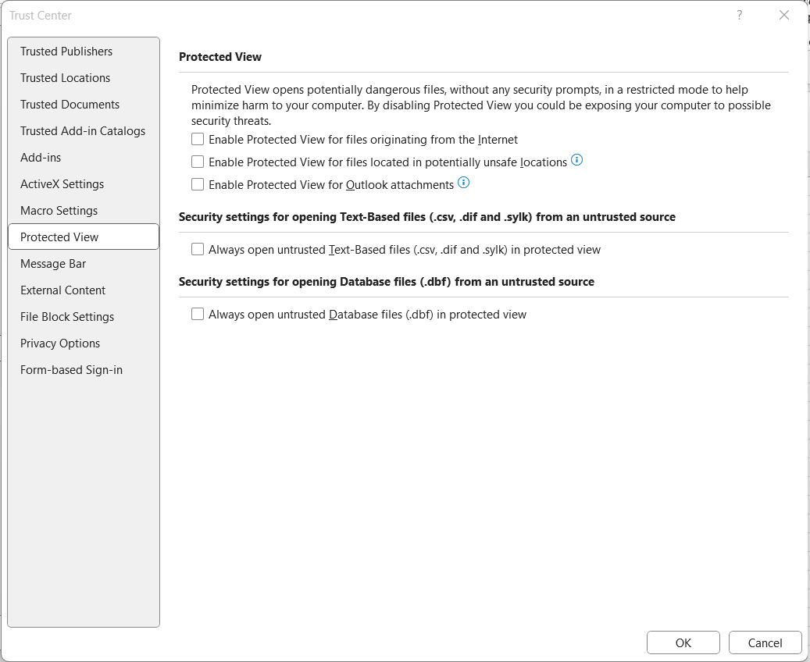
Click on Protected View > Uncheck all

Slide 12
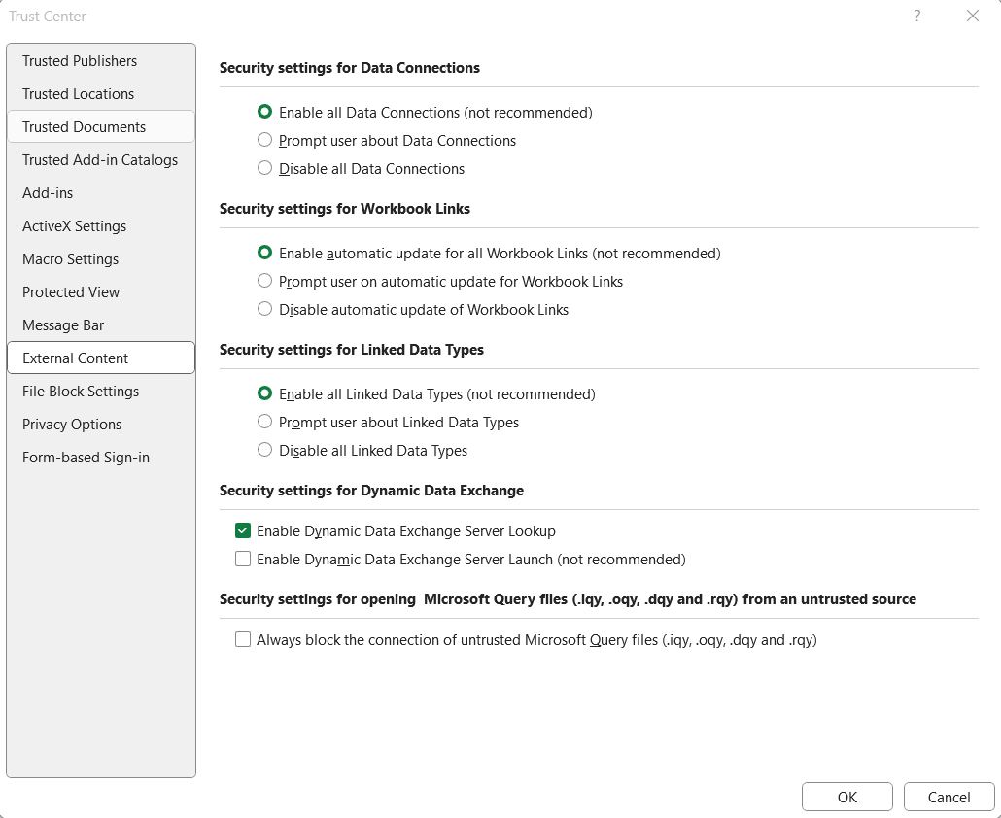
Click on External Content > Select Enable All Data > Select Enable automatic update for all Workbook Links > Select Enable All Linked Data Types > Click on OK.

Slide 13
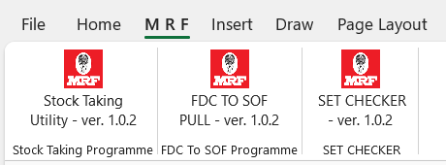
After completing above processes, new tab “M R F” will get automatically added in Excel Ribbon and will display following tools.
Please note that moving file ‘StockTaking55.xlam to other path or renaming this file after adding to excel, will lead to disappearance of “M R F” tab from Excel ribbon.

